Slide 1

CYBER SECURITY AND ETHICAL HACKING PROJECT
Made by:-
Vandan Patel
patelvandan121@gmail.com
98981-06416
This Photo by Unknown Author is licensed under CC BY
i

Slide 2
What do we have here :-
Report of Vulnerability Assessment on testphp.vulnweb.com
Report of Vulnerability Assessment of my virtual machine (Win 7 ultimate)
Cracking the password of username ‘varun’
Hiding a video in a image and retrieving it back
ii

Slide 3
Index :-
General instructions for VA reports …………………………………………………………………………. 1
VA report of testphp.vulnweb.com …………………………………………………………………………. 4
VA report of win 7 ultimate …………………………………………………………………………. 21
Password of ‘varun’ …………………………………………………………………………. 41
Steganography …………………………………………………………………………. 49
iii

Slide 4

General instructions for VA reports
What we performed : -
A black box external vulnerability assessment was performed by us, using automatic scanners as well as manual methods.
We aimed to find all those Critical, Medium and Low vulnerabilities in your system which are a potential threats if exploited purposefully to cause harm.
Results and solutions :-
With the help our thorough assessment, we provided you a detailed report of every vulnerability regardless of its severity and even mentioned possible solutions.
1
General instructions for VA reports

Slide 5
General instructions for VA reports
Sequence of steps performed :-
Extensive scans on all the open ports and available ports, services, servers and applications (using automatic scanner).
We performed scan on all those services where human intervention was necessary (manual scan).
We tried to find proof and solutions of all vulnerabilities along with classifying them according to their impact level.
We made this report to make sure all those vulnerabilities are taken care of from your side.
We do not ensure you that we found all the vulnerabilities in your system (perfection is just a myth). So we recommend you to keep updating your system to the latest version available and at regular interval of time, get your system assessed by a cyber professional.
***DISCLAIMER***
2
General instructions for VA reports

Slide 6

General instructions for VA reports
Risk Definition :-
CRITICAL
Weakness in controls that represent exposure to the organization or risks that could seriously compromise the control framework, data integrity and/ or operational efficiency. These risks need to be addressed with utmost priority.
MEDIUM
Potential weakness in controls, which could develop into a exposure. Or issues that represent areas of concern and mayimpact controls. They should be addressed reasonable promptly.
LOW
Potential weakness in controls, which in combination with other weaknesses can develop into exposure. Suggested improvements not immediately/ directly affecting controls.
3
General instructions for VA reports

Slide 7

Vulnerability Assessment Report of testphp.vulnweb.com
testphp.vulnweb.com
This Photo by Unknown Author is licensed under CC BY-SA-NC
4
VA report of testphp.vulnweb.com

Slide 8
Vulnerability Statistics
Severity | Count
CRITICAL | 2
MEDIUM | 4
LOW | 1
5
VA report of testphp.vulnweb.com

Slide 9
1. PHP Unsupported Version Detection
Synopsis :-
The remote host contains an unsupported version of a web application scripting language.
Description :-
According to its version, the installation of PHP on the remote host is no longer supported. Lack of support implies that no new security patches for the product will be released by the vendor. As a result, it is likely to contain security vulnerabilities.
Solutions :-
Upgrade to a version of PHP that is currently supported.
CRITICAL
CVSS SCORE
10
6
VA report of testphp.vulnweb.com

Slide 10
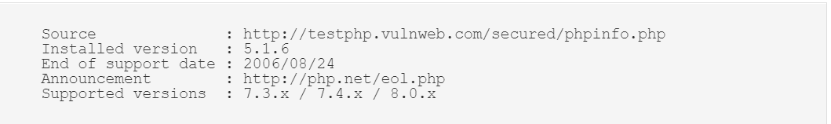
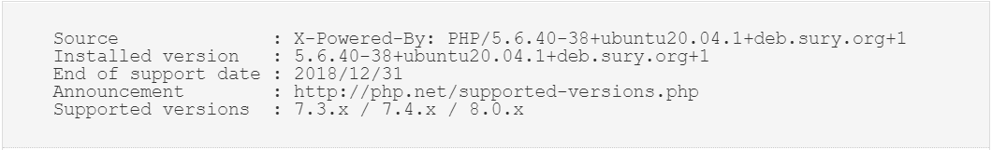
1. PHP Unsupported Version Detection
CRITICAL
7
VA report of testphp.vulnweb.com

Slide 11
2. CGI Generic SQL Injection
Synopsis :-
A web application is potentially vulnerable to SQL injection.
Description :-
By providing specially crafted parameters to CGIs, we were able to get an error from the underlying database. This error suggests that the CGI is affected by a SQL injection vulnerability. An attacker may exploit this flaw to bypass authentication, read confidential data, modify the remote database, or even take control of the remote operating system.
Solutions :-
Modify the relevant CGIs so that they properly escape arguments.
CRITICAL
CVSS SCORE
7.5
8
VA report of testphp.vulnweb.com

Slide 12
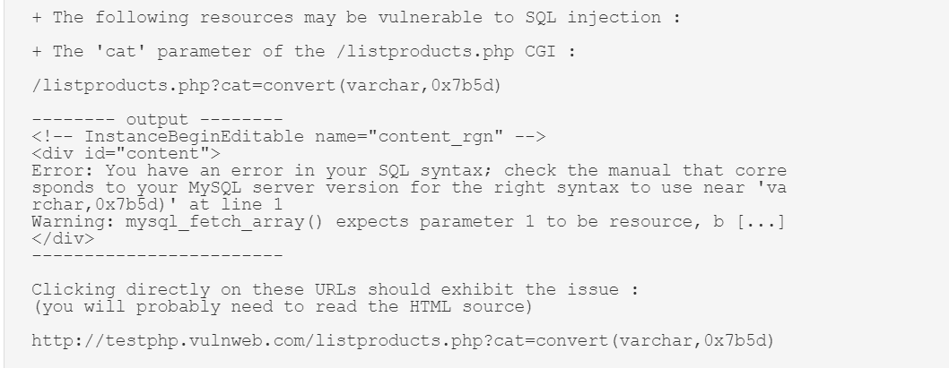
2. CGI Generic SQL Injection
CRITICAL
9
VA report of testphp.vulnweb.com

Slide 13
3. Browsable Web Directories
Synopsis :-
Some directories on the remote web server are browsable.
Description :-
Multiple plugins(automatic scanner) identified directories on the web server that are browsable.
Solutions :-
Make sure that browsable directories do not leak confidential information or give access to sensitive resources. Additionally, use access restrictions or disable directory indexing for any that do.
MEDIUM
CVSS SCORE
5.3
10
VA report of testphp.vulnweb.com

Slide 14
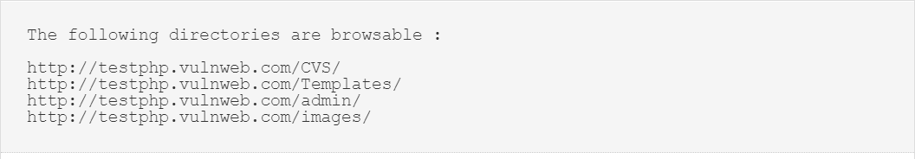
3. Browsable Web Directories
MEDIUM
11
VA report of testphp.vulnweb.com

Slide 15
4. CGI Generic Cookie Injection Scripting
Synopsis :-
The remote web server is prone to cookie injection attacks.
Description :-
The remote web server hosts at least one CGI script that fails to adequately sanitize request strings with malicious JavaScript. By leveraging this issue, an attacker may be able to inject arbitrary cookies. Depending on the structure of the web application, it may be possible to launch a 'session fixation' attack using this mechanism.
Solutions :-
Restrict access to the vulnerable application. Contact the vendor for a patch or upgrade.
MEDIUM
CVSS SCORE
4.3
12
VA report of testphp.vulnweb.com

Slide 16
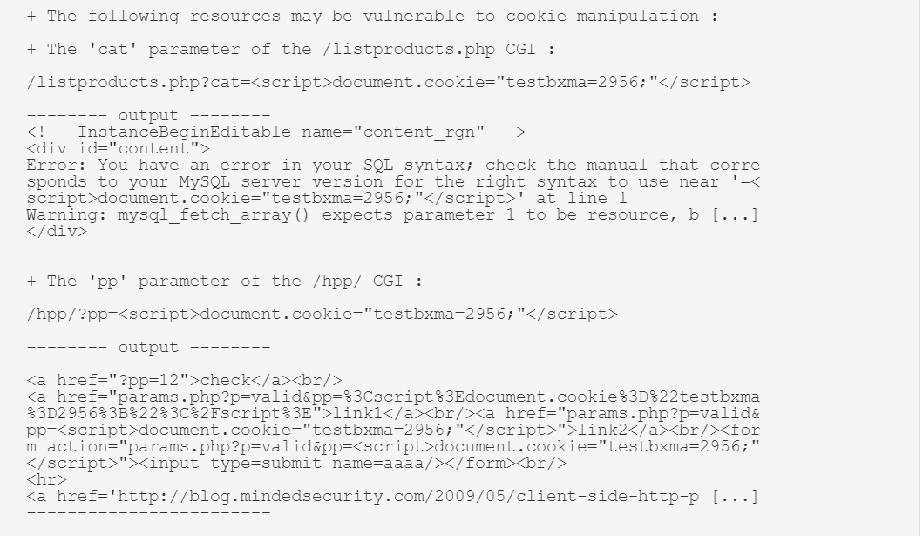
4. CGI Generic Cookie Injection Scripting
MEDIUM
13
VA report of testphp.vulnweb.com

Slide 17
5. Web Application Potentially Vulnerable to Clickjacking
Synopsis :-
The remote web server may fail to mitigate a class of web application vulnerabilities.
Description :-
The remote web server does not set an X-Frame-Options response header or a Content-Security-Policy 'frame-ancestors' response header in all content responses. This could potentially expose the site to a clickjacking or UI redress attack, in which an attacker can trick a user into clicking an area of the vulnerable page that is different than what the user perceives the page to be. This can result in a user performing fraudulent or malicious transactions. X-Frame-Options has been proposed by Microsoft as a way to mitigate clickjacking attacks and is currently supported by all major browser vendors.
Solutions :-
Return the X-Frame-Options or Content-Security-Policy (with the 'frame-ancestors' directive) HTTP header with the page's response. This prevents the page's content from being rendered by another site when using the frame or iframe HTML tags.
MEDIUM
CVSS SCORE
4.3
14
VA report of testphp.vulnweb.com

Slide 18
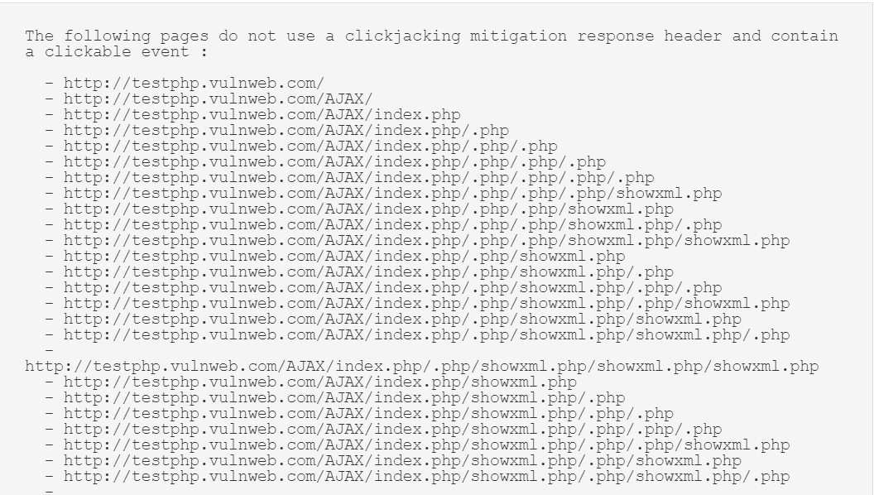
5. Web Application Potentially Vulnerable to Clickjacking
MEDIUM
15
VA report of testphp.vulnweb.com

Slide 19
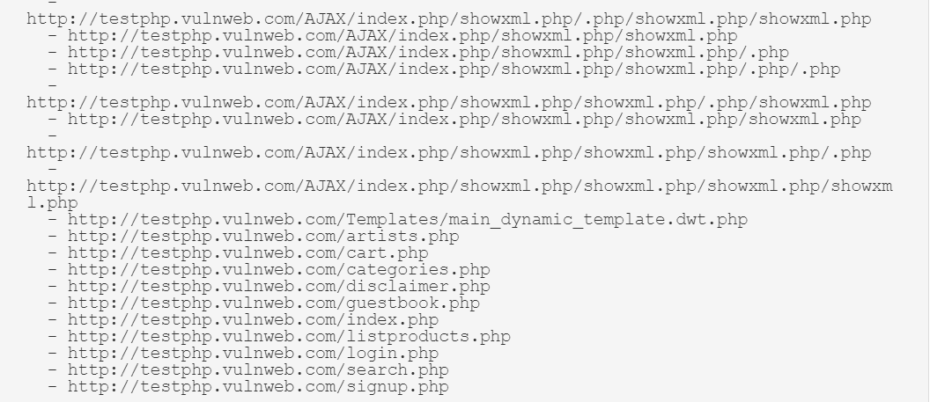
5. Web Application Potentially Vulnerable to Clickjacking
MEDIUM
16
VA report of testphp.vulnweb.com

Slide 20
6. Web Application SQL Backend Identification
Synopsis :-
A web application's SQL backend can be identified.
Description :-
At least one web application hosted on the remote web server is built on a SQL backend that we were able to identify by looking at error messages. Leaking this kind of information may help an attacker fine-tune attacks against the application and its backend.
Solutions :-
Filter out error messages.
MEDIUM
CVSS SCORE
5.0
17
VA report of testphp.vulnweb.com

Slide 21
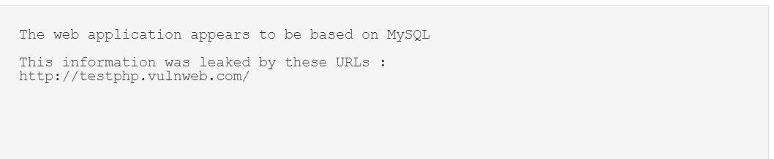
6. Web Application SQL Backend Identification
MEDIUM
18
VA report of testphp.vulnweb.com

Slide 22
7. Web Server Transmits Cleartext Credentials
Synopsis :-
The remote web server might transmit credentials in cleartext.
Description :-
The remote web server contains several HTML form fields containing an input of type 'password' which transmit their information to a remote web server in cleartext. An attacker eavesdropping the traffic between web browser and server may obtain logins and passwords of valid users.
Solutions :-
Make sure that every sensitive form transmits content over HTTPS.
MEDIUM
CVSS SCORE
2.0
19
VA report of testphp.vulnweb.com

Slide 23
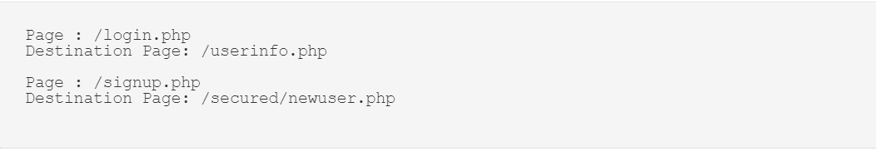
7. Web Server Transmits Cleartext Credentials
MEDIUM
20
VA report of testphp.vulnweb.com

Slide 24
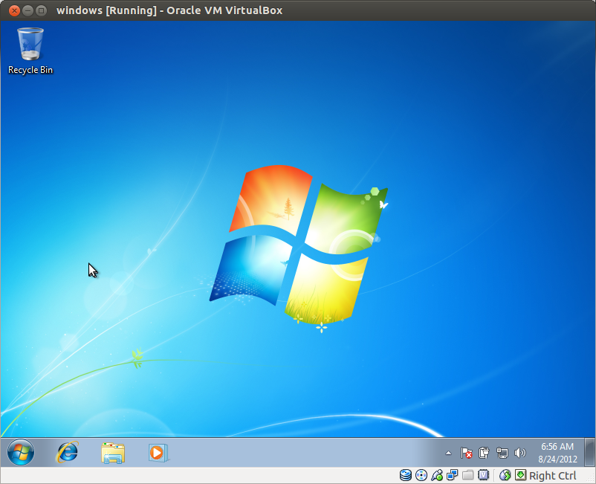
Vulnerability Assessment Report of Win 7 ultimate(Virtual Machine)
This Photo by Unknown Author is licensed under CC BY-SA
21
VA report of Win 7 ultimate

Slide 25
Vulnerability Statistics
Severity | Count
CRITICAL | 3
MEDIUM | 5
LOW | 1
22
VA report of Win 7 ultimate

Slide 26
1. Guest Account is enabled and have no password
Synopsis :-
This check determines whether the bult-in Guest account is enabled on the scanned computer. And we observed that Guest Account is enabled and have no password.
Description :-
This account allows unauthenticated users to gain access to the system by logging on as a Guest with no password. Unauthorized users can access any resources that are accessible to the Guest account over the network. This means that any network shared folders with permissions thar allow access to the Guest account, the Guest group, or the Everyone group will be accessible over the network. This can lead to the exposure or corruption of data.
Solutions :-
Set Guest account status to Disabled so that the built-in Guest account is no longer usable. Also always have a password to every user.
CRITICAL
CVSS SCORE
10
23
VA report of Win 7 ultimate

Slide 27
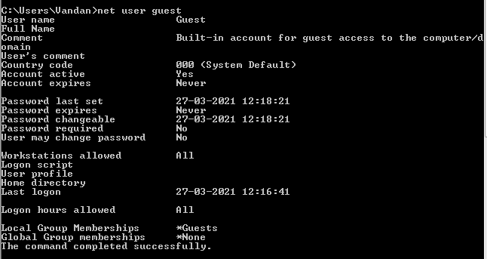
1. Guest Account is enabled and have no password
CRITICAL
24
VA report of Win 7 ultimate

Slide 28
2. Lack of Antivirus and outdated windows defender
Synopsis :-
Our security check-up reported us that you don’t have any antivirus installed and even windows defender is out dated.
Description :-
Antivirus and windows defender are backbones of Windows OS, without them you can’t detect viruses, worms, malwares, trojans and many other threats which can lead to system override(remote access), data leakage, data corruption, system corruption, and many other hacking acts.
Solutions :-
Update Windows Defender to its latest version available and always keep a Antivirus to get extra add-up for security of your server.
CRITICAL
CVSS SCORE
10
25
VA report of Win 7 ultimate

Slide 29
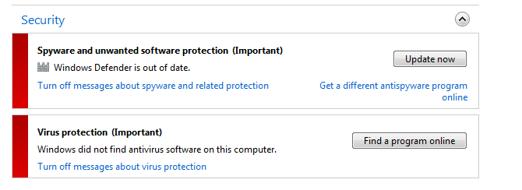
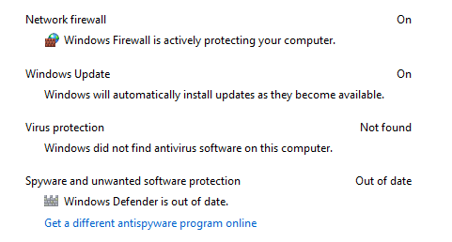
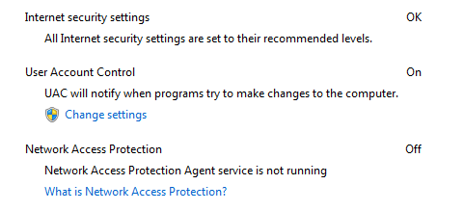
2. Lack of Antivirus and outdated windows defender
CRITICAL
26
VA report of Win 7 ultimate

Slide 30
3. Windows not Activated
Synopsis :-
Your OS is not officially recognized by Microsoft.
Description :-
Using activated version is necessary to ensure your all internet services are updated up to its mark. Using inactivated version can fail to do so and will keep some ports and services out of date which can be exploited and attacker might perform various attacks like backdoor, RAT, system override(remote access) any many other.
Solutions :-
We recommend you to keep the latest version of Windows available or at least keep your current windows activated.
CRITICAL
CVSS SCORE
10
27
VA report of Win 7 ultimate

Slide 31
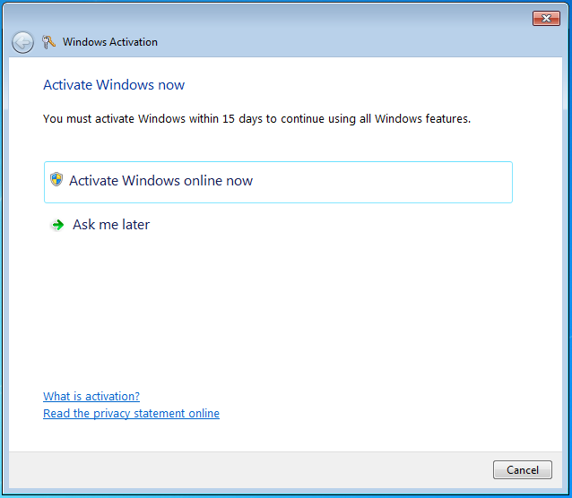
3. Windows not Activated
CRITICAL
28
VA report of Win 7 ultimate

Slide 32
4. No Security Policy found for passwords
Synopsis :-
We observed that No password policy has applied on both of the servers, Users can set general password.
Description :-
General password are easy to guess and are prone to hack by using dictionary and brute force attacks.
Solutions :-
Always have a password policy of minimum 8 characters which includes 1 special character, 1 capital letter and 1 numeric number.
MEDIUM
CVSS SCORE
6.0
29
VA report of Win 7 ultimate

Slide 33
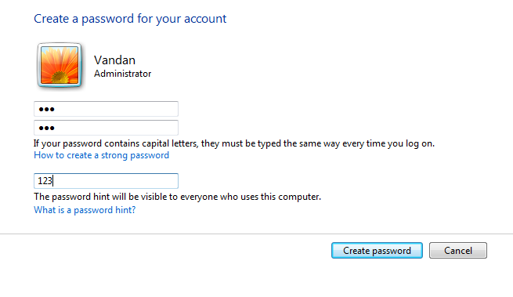
4. No Security Policy found for passwords
MEDIUM
30
VA report of Win 7 ultimate

Slide 34
5. SSL Self-Signed (Unauthorized) certificate
Synopsis :-
The SSL certificate chain for this service ends in an unrecognized self-signed certificate.
Description :-
The X.509 certificate chain for this service is not signed by a recognized certificate authority. If the remote host is a public host in production, this nullifies the use of SSL as anyone could establish a man-in-the-middle attack against the remote host.
Solutions :-
Purchase or generate a proper SSL certificate for this service.
MEDIUM
CVSS SCORE
6.4
31
VA report of Win 7 ultimate

Slide 35
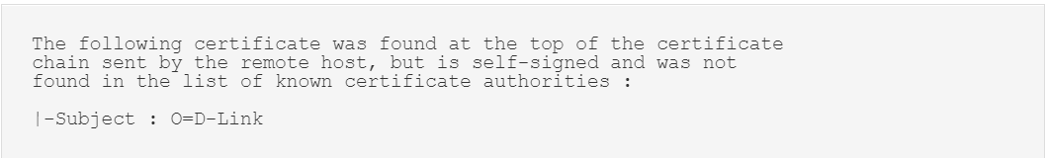
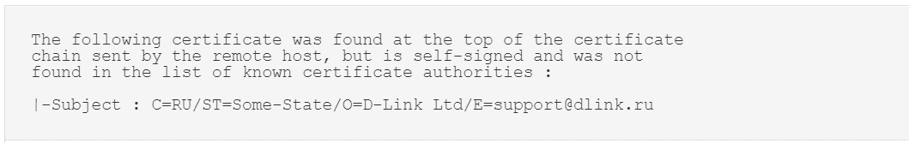
5. SSL Self-Signed (Unauthorized) certificate
MEDIUM
32
VA report of Win 7 ultimate

Slide 36
6. TLS Version 1.0 Protocol Detection
Synopsis :-
The remote servise encrypts traffic using an older version of TLS.
Description :-
The remote service accepts connections encrypted using TLS 1.0. TLS 1.0 has a number of cryptographic design flaws. Modern implementations of TLS 1.0 mitigate these problems, but newer versions of TLS like 1.2 and 1.3 are designed against these flaws and should be used whenever possible.
Solutions :-
Enable support for TLS 1.2 and 1.3, and disable support for TLS 1.0.
MEDIUM
CVSS SCORE
6.5
33
VA report of Win 7 ultimate

Slide 37
6. TLS Version 1.0 Protocol Detection
MEDIUM
34
VA report of Win 7 ultimate

Slide 38
7. DNS Server Cache Snooping Remote Information Disclosure
Synopsis :-
The remote DNS server is vulnerable to cache snooping attacks.
Description :-
The remote DNS server responds to queries for third-party domains that do not have the recursion bit set. This may allow a remote attacker to determine which domains have recently been resolved via this name server, and therefore which hosts have been recently visited.
Solutions :-
Contact the vendor of the DNS software for a fix.
MEDIUM
CVSS SCORE
5.3
35
VA report of Win 7 ultimate

Slide 39
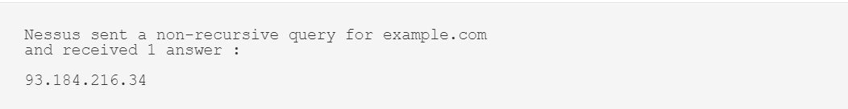
7. DNS Server Cache Snooping Remote Information Disclosure
MEDIUM
36
VA report of Win 7 ultimate

Slide 40
8. IP Forwarding Enabled
Synopsis :-
The remote host has IP forwarding enabled.
Description :-
The remote host has IP forwarding enabled. An attacker can exploit this to route packets through the host and potentially bypass some firewalls / routers / NAC filtering. Unless the remote host is a router, it is recommended that you disable IP forwarding.
Solutions :-
On Windows, set the key 'IPEnableRouter' to 0 under HKEY_LOCAL_MACHINE\System\CurrentControlSet\Services\Tcpip\Parameters
MEDIUM
CVSS SCORE
4.7
37
VA report of Win 7 ultimate

Slide 41
8. IP Forwarding Enabled
MEDIUM
38
VA report of Win 7 ultimate

Slide 42
9. DHCP Server Detection
Synopsis :-
The remote DHCP server may expose information about the associated network.
Description :-
This script contacts the remote DHCP server (if any) and attempts to retrieve information about the network layout. Some DHCP servers provide sensitive information such as the NIS domain name, or network layout information such as the list of the network web servers, and so on.
Solutions :-
Apply filtering to keep this information off the network and remove any options that are not in use.
LOW
CVSS SCORE
3.3
39
VA report of Win 7 ultimate

Slide 43
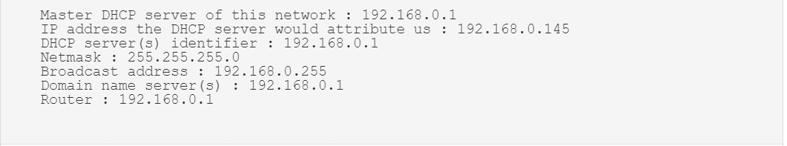
9. DHCP Server Detection
LOW
40
VA report of Win 7 ultimate

Slide 44


Decrypting password of user ‘varun’ from a shadow file
This Photo by Unknown Author is licensed under CC BY-NC-ND
41
Decrypting password of user ‘varun’

Slide 45
Steps performed to decrypt the password :-
Downloaded the zip file from www.varunpathak.in/m1ss10n.zip which contained the shadowed to be decrypted.
The zip file was password protected, I used dictionary attack using ‘rockyou.txt’.
Zip file contained a .txt which had username and password in hash format, so I used john the ripper and decrypted all the hashes.
42
Decrypting password of user ‘varun’

Slide 46
Step 1:- Cracking the Zip password
I used the below command to perform dictionary attack :-
1. 2. 3. 4. 5. 6.
fcrackzip -D -p rockyou.txt -u m1ss10n.zip
Let’s discuss each element of the above command:-
“fcrackzip” – name of tool used
“-D” – states for dictionary attack
“-p” – it states that everything after it and before next space should
define the password file for dictionary attack (address/name)
43
Decrypting password of user ‘varun’

Slide 47
Step 1:- Cracking the Zip password
“rockyou.txt” – it is the name of password file for dictionary attack
“-u” – it states that not only try different password but even stat
which password is correct
6. “m1ss10n.zip” – name of target file
44
Decrypting password of user ‘varun’

Slide 48
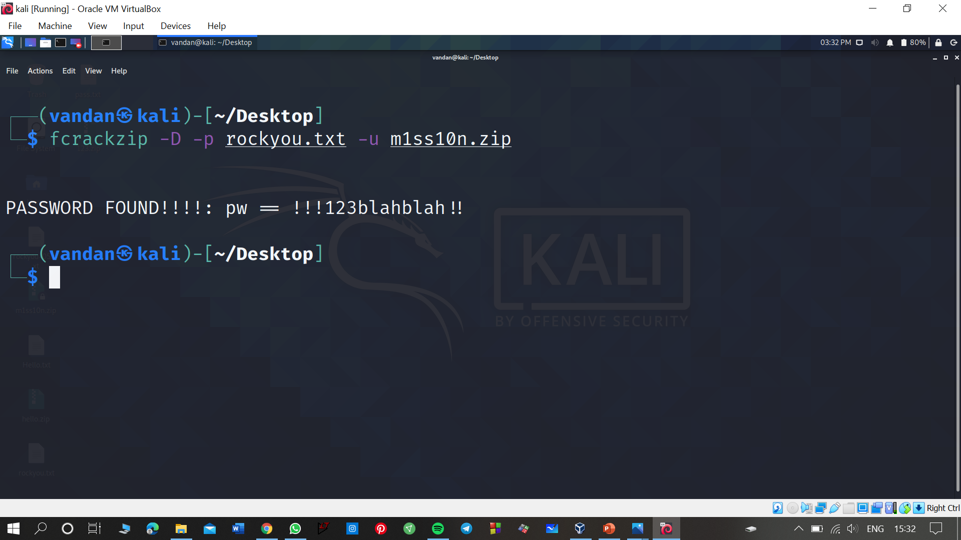
Step 1:- Cracking the Zip password
45
Decrypting password of user ‘varun’

Slide 49
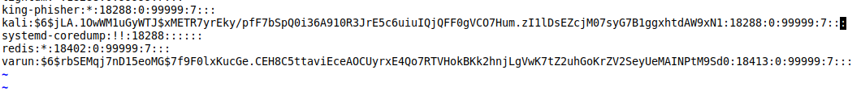
Inside the .zip file
Zip file contained a .txt file named “pass.txt” which contained some random hashes which was impossible to decode by a human being.
Here is some part of that .txt file
46
Decrypting password of user ‘varun’

Slide 50
Step 2:- Decrypting the hashes using john the ripper
Hashes used the SHA512 algorithm.
So I used the below command to decrypt the file :-
1. 2. 3.
john pass.txt --show
Let’s discuss each element of the above command:-
“john” – name of tool used (john the ripper)
“pass.txt” – name of target file
“--show” – shows password and username pair uniquely.
47
Decrypting password of user ‘varun’

Slide 51
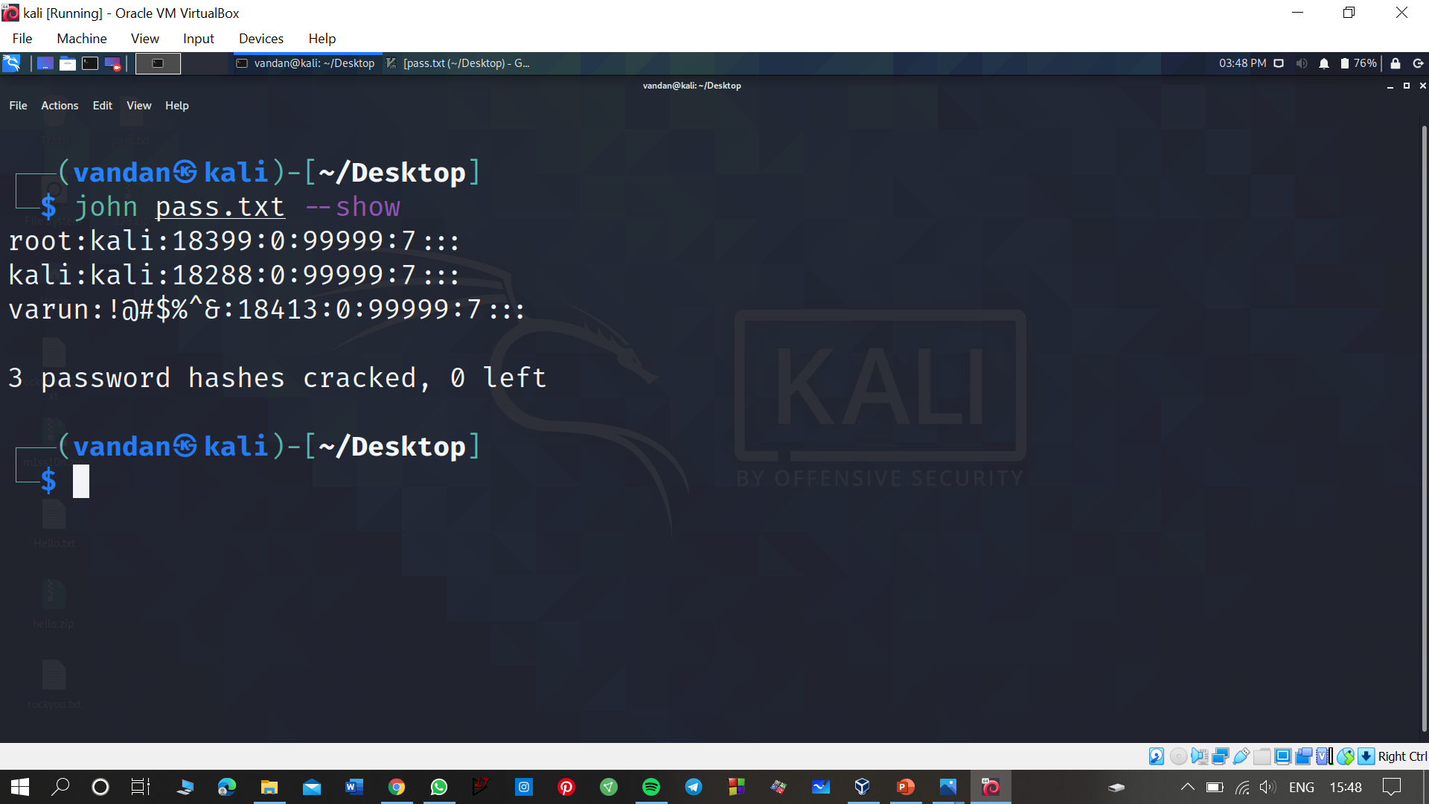
Step 2:- Decrypting the hashes using john the ripper
Clearly our target user ‘varun’ has password string as “!@#$%^&”
48
Decrypting password of user ‘varun’

Slide 52


Hiding a video in a image and retrieving it back
This Photo by Unknown Author is licensed under CC BY-NC
49
Stegnatography

Slide 53
Steps performed to do this trick
Gather the subject photo and target video in a folder, let’s say in ‘project’ folder on desktop
Zip the video file and name it accordingly
Used command prompt to merge the files
Retrieved the required video using winrar
50
Stegnatography

Slide 54
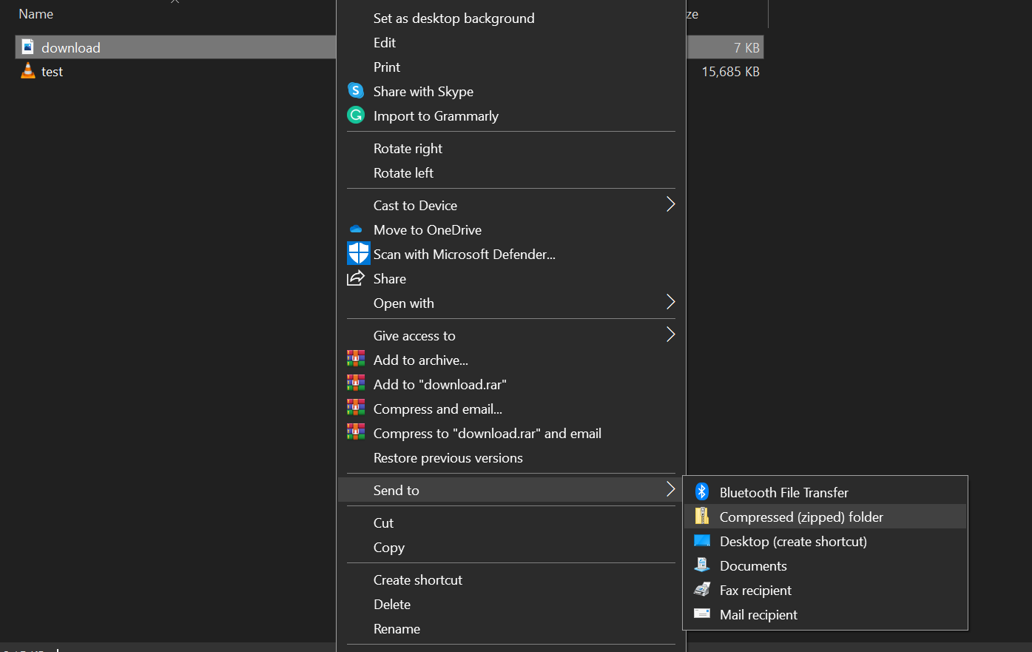
Step 1:- Zipping the video
Right click on the video → send to → compressed zipped folder
51
Stegnatography

Slide 55
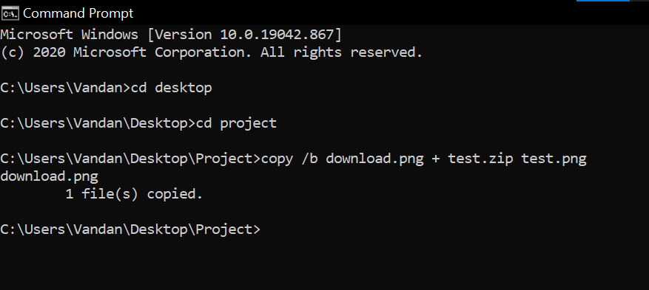
Step 2:- Merging both files using command prompt
Navigate to your destined folder from command prompt then the following command :-
copy /b imagename + zipname finalimagename
52
Stegnatography

Slide 56
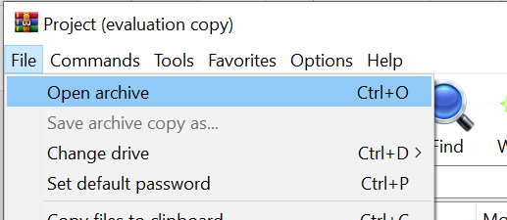
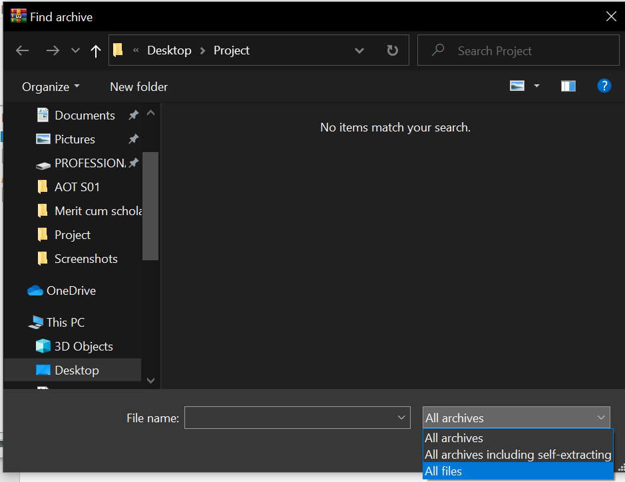
Step 3:- Retrieving your video back
To retrieve your video back, follow the given steps:-
Open winrar→Files(top left)→Open Archive→ set file type as “All Files”→ select your final image→select the video you want to retrieve
53
Stegnatography

Slide 57
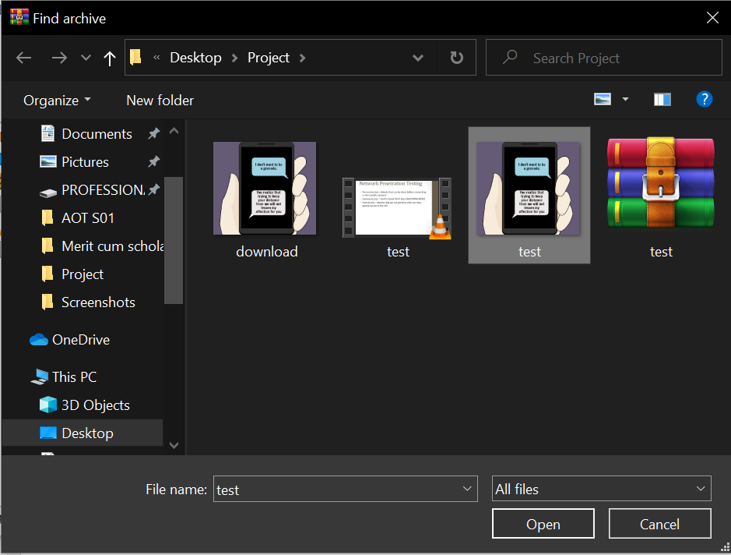
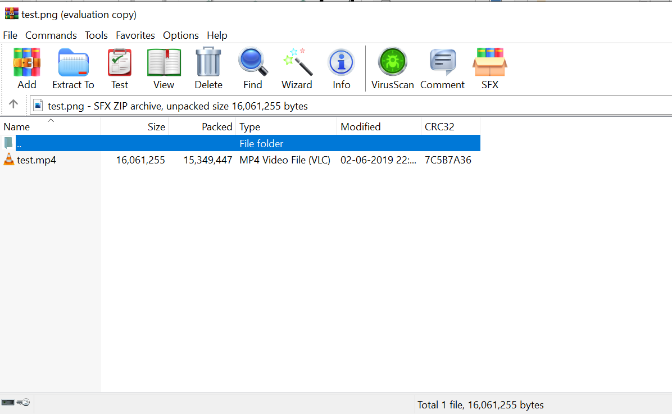
Step 3:- Retrieving your video back
Select the final image and retrieve required video.
54
Stegnatography

